Slide 1

Smart Navigation Stick for Visually Impaired Adults Using Arduino
Microprocessor And Embedded System
Section :Q
Group : 08
Supervised by: PROTIK PARVEZ SHEIKH

Slide 2


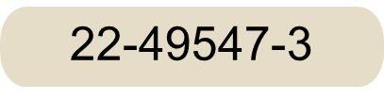
1
GROUP MEMBERS
MD. AL-IMRAN SAYEM
22-48023-2
MD TANJIL TASHRIK ZIM
22-48021-2
MD. ABRAR RAFID SHARIAR
22-48055-2
SANJUKTA DAS
22-47801-2
HUMAIRA ZANNAT
22-47789-2

Slide 3
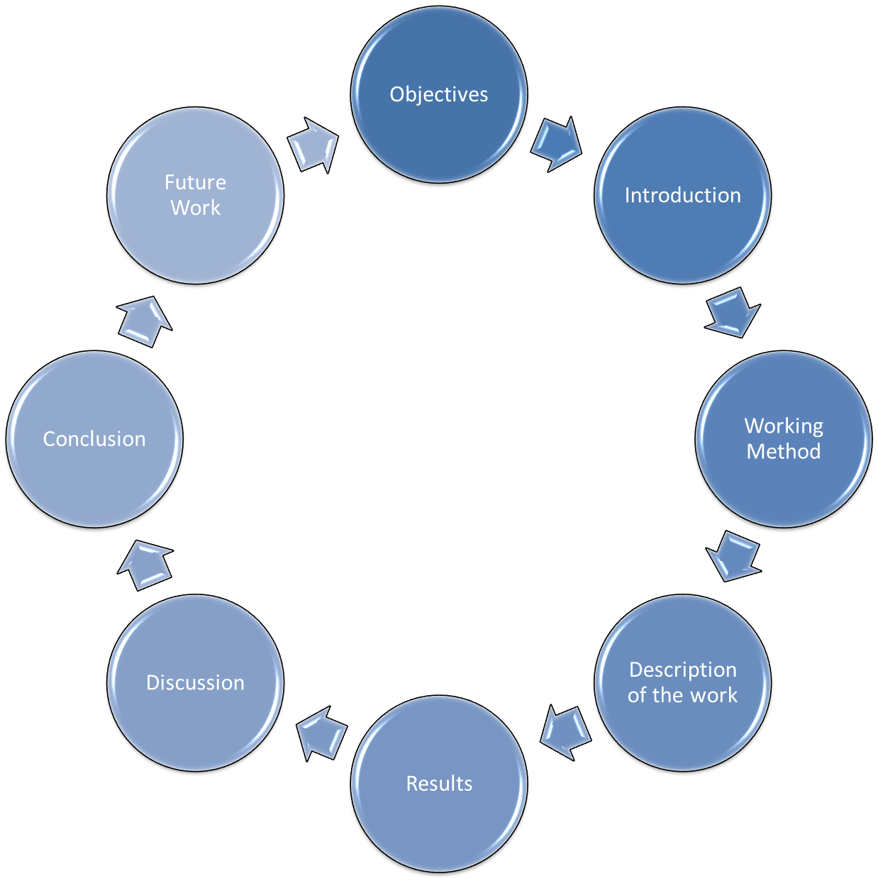
OVERVIEW
2

Slide 4
3
OBJECTIVE
Create a Smart Navigation Stick for safer mobility of visually impaired people.
Use sensors to detect obstacles (0-60 cm) with buzzer alerts.
Use a water sensor to detect water with a separate alarm setting from obstacle alerts
Design it to be lightweight, ergonomic, and easy to use.
Use affordable components to keep costs low.
Ensure it works reliably indoors and outdoors.

Slide 5
4
INTRODUCTION
1. Background
Navigating safely is a major challenge for visually impaired individuals.
Over 2.2 billion people worldwide have some form of visual impairment (WHO).
Traditional aids like guide dogs and white canes often fail to detect hazards such as water or low-lying obstacles.
2.Motivation
Affordable microcontroller technology offers an opportunity to enhance safety and independence.
Developing a smart navigation stick can address these challenges by combining modern technology with user-friendly design.

Slide 6
INTRODUCTION
5
3.Project Overview
Designed a smart navigation stick with ultrasonic sensors and water sensors for obstacle detection and hazard identification
Provides real-time audio feedback to guide users effectively in dynamic environments.
4.Significance
Bridges the gap between traditional aids and modern technology.
Promotes independence, safety, and inclusivity for visually impaired individuals.
Combines cost-effective hardware with an ergonomic, user-centric design.

Slide 7
6
Research (findings from paper)
Research highlights the need for improved mobility and safety for visually impaired individuals.
Solutions include ultrasonic sensors for obstacle detection, laser sensors for gap identification, water-resistant sensors for detecting water hazards with distinct alerts, and GSM/GPS modules for emergency communication.
Real-time vibration, audio alerts, and voice commands enhance navigation. Arduino-based microcontrollers efficiently integrate and process sensor data, ensuring reliable feedback.
Future improvements focus on power optimization, Artificial intelligence, multi-sensor calibration, and user-driven testing to refine performance, offering greater independence and confidence in daily navigation
.

Slide 8
Working Method
7
Obstacle Detection:
The ultrasonic sensor emits ultrasonic waves and measures the time taken for the echo to return.
Based on this time, the distance to nearby obstacles is calculated.
If an obstacle is detected at a distance within a certain range, the system triggers alerts.
Feedback System:
The buzzer is used to notify the user of water hazards ahead.
0–30 cm: Short, fast beeps to indicate very close water.
30–60 cm: Slower beeps to warn of water slightly farther away.
Control Logic:
The Arduino Uno processes input from the sensors and executes programmed logic to control the buzzer
Notes:
Assalamu alaikum sir, My name is …. , I will explain how our project works.. How our system detects obstacles. The Ultrasonic sensor sends waves and measures the time they take to bounce back.
From this it calculates the distance to an object. Based of the distance , the buzzer gives alert, If the object is between 30 to 60 cm, it beeps slowly, if it closer than 30cm, it beeps quickly,This helps user to understand how far the obstacles if

Slide 9
Working Method
8
Water Detection:
The water sensor detects the presence of water on the path ahead.
It works by identifying conductivity across its probes when in contact with water.
If water is detected at a distance within a certain range, the system triggers alerts.
Feedback System:
The buzzer is used to notify the user of water hazards ahead..
Control Logic:
The Arduino Uno processes signals from the water sensor.
Notes:
We used another sensor that is water sensor module. The water sensor works by checking if water touches its probes, When it detects water, the bazzer is triggered with a different beep pattern

Slide 10
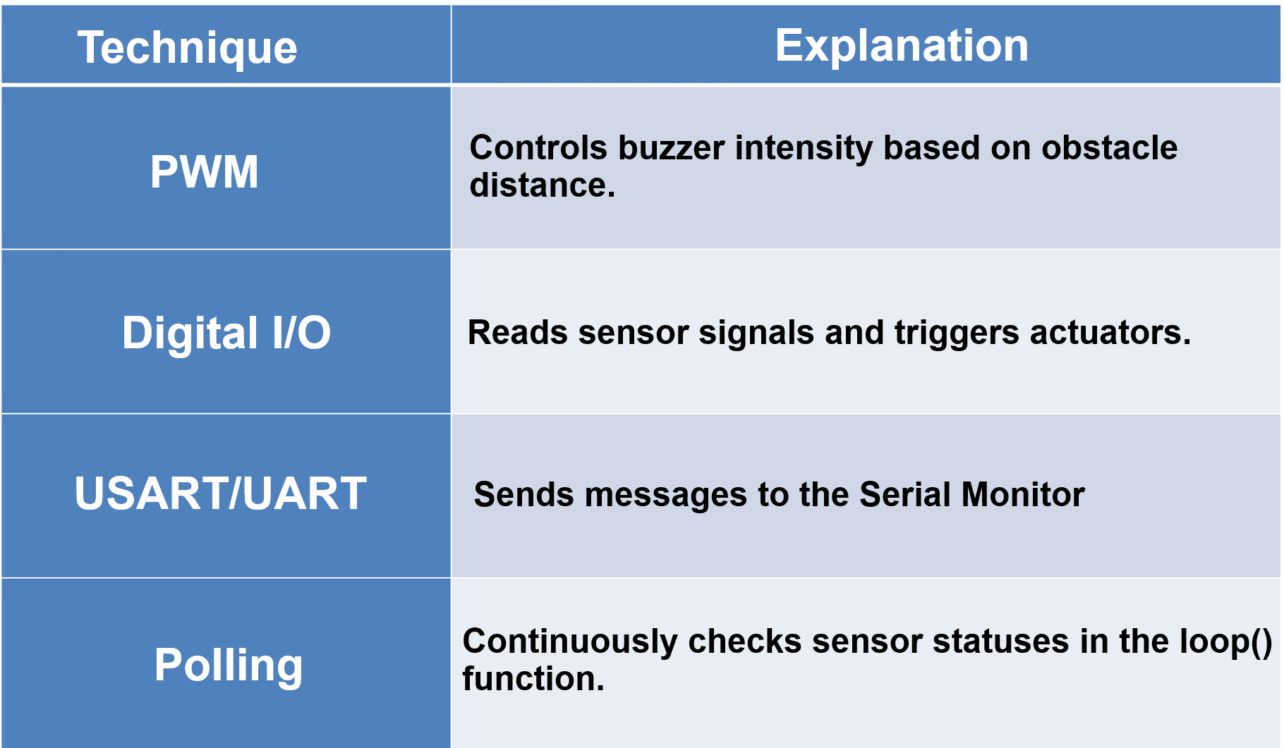
Working Method
9

Slide 11
10
Description of the work
System Components:
Arduino Uno: Processes data and controls outputs.
Ultrasonic Sensor: Detects obstacles by measuring distance (0- 60cm)
Water Sensor: Detects water instantly when it comes in contact with the ground, helping to prevent slips and falls.
Buzzer: Provides sound feedback.
Power Supply: 9V battery powers the system.

Slide 12
11
Description of the work
Component Setup
Arrangement: Place Arduino, Ultrasonic Sensor, Water Sensor Module and Buzzer on the breadboard.
Connections:
Ultrasonic Sensor: TrigPin to D9, EchoPin to D10.
Buzzer: Connect to D8.
Water Sensor : Connect to A0
Power: Use a 9V battery; ensure proper grounding.
Circuit Connections
Connect the ultrasonic sensor, water sensor, and buzzer to the Arduino as per the specified pins:.
Ensure stable power supply.

Slide 13
12
Description of the work
Here is a short video demonstration of our project in action:.

Slide 14
13
Description of the work
Workflow:
Power On: Activates Arduino and sensors.
Obstacle Detection: Ultrasonic sensor detects obstacles by calculating distance(30-60cm); the buzzer's intensity increases as the object gets closer(0-30).
Water Detection: Water sensor triggers buzzer instantly on contact with water to prevent slipping.
Outputs:
Obstacle: Buzzer intensity changes, like with distance 40-55 cm, the buzzer beeps 5 time every second. Distance 25-39 cm, the buzzer beeps 10 times every second. When distances less than 25 cm, the buzzer sounds continuously.
water: Buzzer intensity changes, like with distance 31–60 cm, the buzzer beeps 5 times every second with a distinct tone. Distance 0–30 cm, the buzzer beeps 10 times every second with a faster and different sound.

Slide 15
14
Description of the work
Testing and Expected Results:
Obstacle Test: Objects placed within 0–60 cm range; buzzer beeps vary by distance and sound type to indicate proximity.
Water Test: Water is placed on the ground or directly on the sensor; upon contact, the sensor triggers a specific buzzer pattern to alert the user. Expected Results: The system provides accurate real-time feedback for both obstacles and water hazards. Users can distinguish between the two based on buzzer pattern and tone, ensuring safer navigation indoors and outdoors.
.

Slide 16
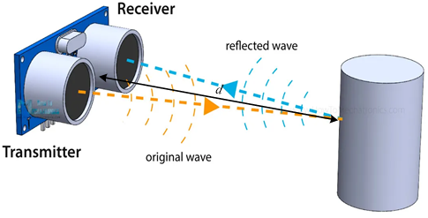
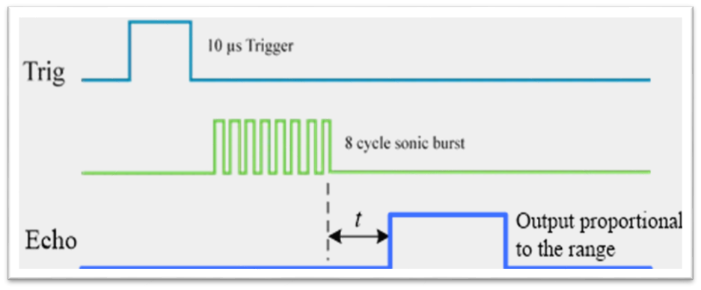
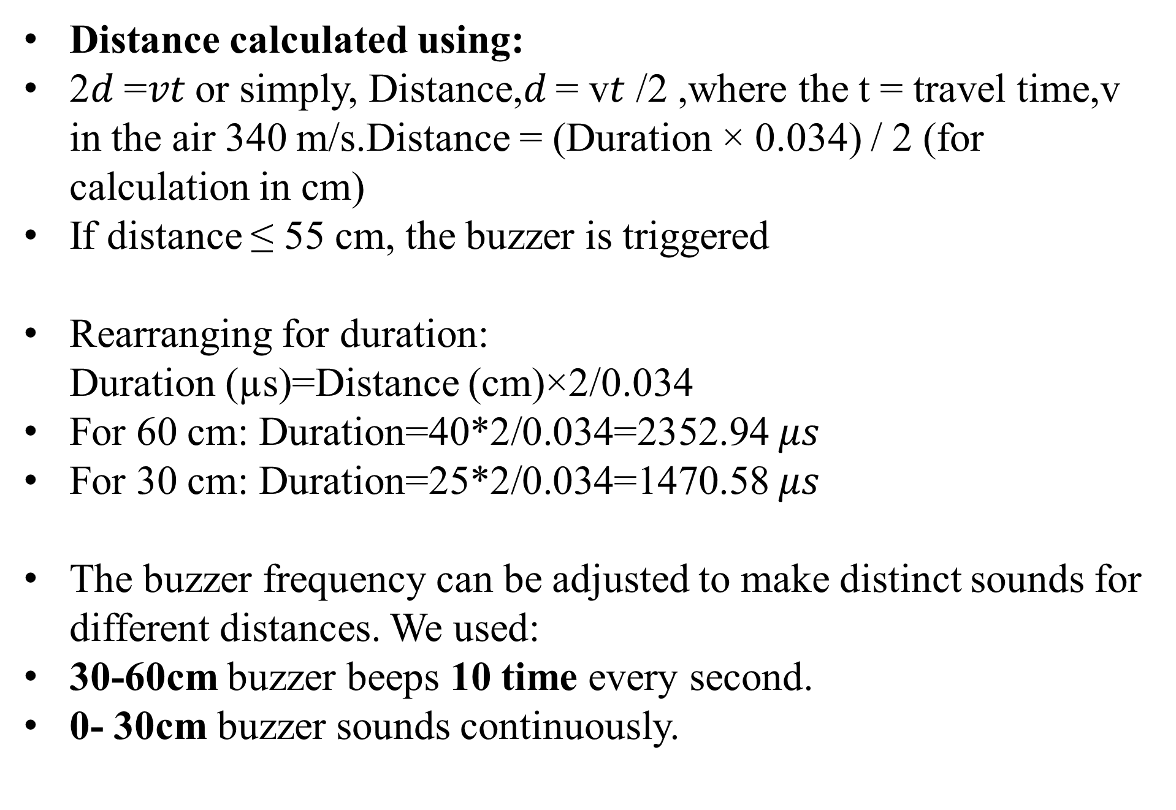
15
Equations/Mathematical Model
Distance calculated using:
2𝑑 =𝑣𝑡 or simply, Distance,𝑑 = v𝑡 /2 ,where the t = travel time,v in the air 340 m/s.Distance = (Duration × 0.034) / 2 (for calculation in cm)
If distance ≤ 55 cm, the buzzer is triggered
Rearranging for duration: Duration (µs)=Distance (cm)×2/0.034
For 60 cm: Duration=40*2/0.034=2352.94 $μs$
For 30 cm: Duration=25*2/0.034=1470.58 $μs$
The buzzer frequency can be adjusted to make distinct sounds for different distances. We used:
30-60cm buzzer beeps 10 time every second.
0- 30cm buzzer sounds continuously.

Slide 17
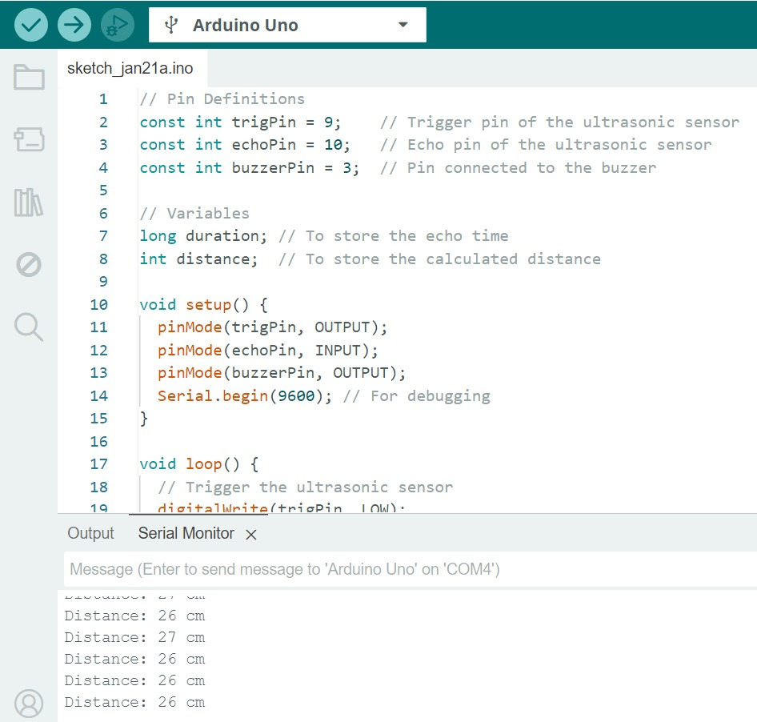
Results (Output)
16
Description: Obstacle detected:(PWM TECNIQUE):
Distance: 13 cm, Duty Cycle: 245“.
The duty cycle -It is commonly expressed as a percentage and directly relates to the power delivered to the buzzer.
Duty Cycle (%)=(PWM Value/255​)×100.For duty cycle 245 displayed in serial display-analogmaps values between 0 to 255:Duty Cycle(%)=(245/255)*100=96.08%
the duty cycle is dynamically calculated based on the distance to an obstacle:
Duty Cycle (PWM Value)=Map(Distance,MinDist,MaxDist,0,255).
MinDist and MaxDist define the range within which the duty cycle varies.The closer the obstacle,the higher the duty cycle,producing a louder orhiger-pitched buzzer sound.

Slide 18
17
Discussions
Obstacle Detection: Ultrasonic sensor detects obstacles within 0-60cm, providing real-time feedback through varying buzzer intensity.
Water Detection Accuracy: Water sensor successfully detected water placed on the ground or over the sensor; distinct buzzer sounds helped differentiate it from obstacle alerts.
System Responsiveness: Real-time buzzer feedback is accurate for both obstacles and water detection.
Simulation vs. Real-World Testing: System performed well in simulations but faced environmental challenges in real-world testing.
Power and Performance: The 9V battery supports consistent performance, but power optimization is possible for extended use.

Slide 19
18
Conclusion
Provides real-time feedback via a buzzer, ensuring effective obstacle and water detection.
Combines ultrasonic and water sensors for accurate and reliable alerts.
Enhances mobility and safety for visually impaired individuals.
Limitations include limited detection range (0–60 cm) and dependency on a 9V power supply.
Offers a cost-effective, portable, and user-friendly solution for safety and environmental monitoring.

Slide 20
19
Future Work
1.Power Optimization: Explore alternative power sources (e.g., solar cells) for extended battery life.
2.User-Centric Design: Add adjustable sensitivity, haptic feedback, and voice commands.
3.Advanced Features: Integrate GPS navigation, real-time tracking, and emergency communication.
3.AI Integration: Implement machine learning for smarter obstacle detection and navigation.
4.Additional Improvements:
Add an audio player for spoken feedback (e.g., "Obstacle ahead at 30 cm").
Integrate context-aware feedback for enhanced system efficiency.

Slide 21
THANK YOU

